Slide 1
Phosphoproteome profiling of iTreg cells
PI and Users:
Hongbo Chi, Lingyun Long & Jun Wei
Proteomics Facility:
Hong Wang, Xusheng Wang, Yuxin Li, Ji-Hoon Cho, Tim Shaw, Junmin Peng
April, 2018

Slide 2
Hypothesis, Aims, and Background
Hypothesis: Phosphoproteomic pattern of WT and mTORC1 deficient iTreg cells, after TCR-restimulation, is different.
Aims:
1. Identify mTORC1 target proteins in iTreg cell (phospho-protein differences between WT and Rator-KO, or DMSO vs. Torin1 treated iTreg cells).
2. Identify upstream activators of mTORC1[Overlap “common changes between WT and Raptor-KO, or DMSO vs. Torin1 treated iTreg cells” with Raptor interactome data (Endogenous FLAG-Raptor IP samples for TMT will be ready soon)].
Background: mTOR signaling is critical for T cell development and function. T cell may have specific mTOR regulation upon TCR stimulation. By combining multiple layers of data (microarray, interactome and phosphoproteome), we should be able to identify novel upstream mTOR regulators or downstream targets.

Slide 3
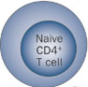
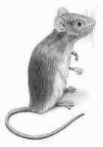
Sample Preparation (User Protocols)
Provided by users
Procedures
 | TMT Tags | Samples name | Cell # | protein amount
1 | 126 | WT, 0 h 1# | 150 million | ~ 2mg
2 | 127N | WT, 0 h 2# | 150 million | ~ 2mg
3 | 127C | WT, 0 h 3# | 150 million | ~ 2mg
4 | 128N | WT, 1h 1# | 150 million | ~ 2mg
5 | 128C | WT, 1h 2# | 150 million | ~ 2mg
6 | 129N | WT+Torin1, 1h 1# | 150 million | ~ 2mg
7 | 129C | WT+Torin1, 1h 2# | 150 million | ~ 2mg
8 | 130N | B6+Cre-RV, 1h 1# | ~80 million | ~ 1mg
9 | 130C | B6+Cre-RV, 1h 2# | ~80 million | ~ 1mg
10 | 131 | Raptor^{fl/fl}+Cre-RV, 1h 1# | ~100 million | ~ 1.4 mg
11 |  | Raptor^{fl/fl}+Cre-RV, 1h 2# | ~100 million | ~ 1.4 mg
iTreg priming condition, 70 h
Rest cells for 2.5 days
Sample 4#-7#, DMSO or Torin1 pretreat iTreg cell for 60 min,
aCD3 (1ug/ml) re-stimulation for 1hr
80~150 million iTreg cells (1-2 mg total protein each) were harvested

Slide 4
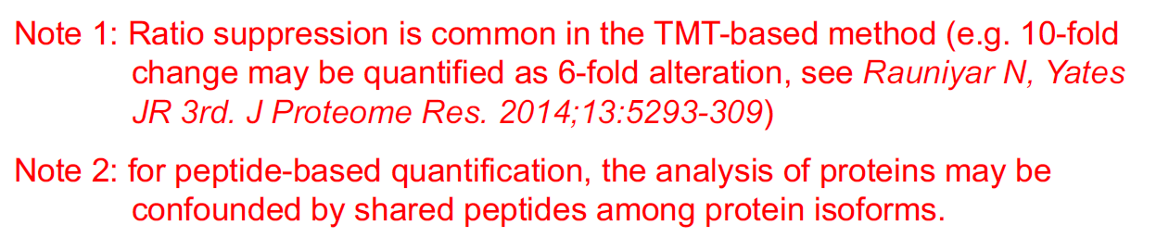
Phos proteome data summary
Start with 10 samples for 10-plex TMT analysis
MS analysis of 38 LC-MS/MS runs
Accepted 365, 357 peptide spectrum matches
Identified 64,749 unique phosphopeptides
Identified 44,760 unique phosphosites (false discovery rate <1%)
Quantified 44,097 unique phosphopeptides

Slide 5
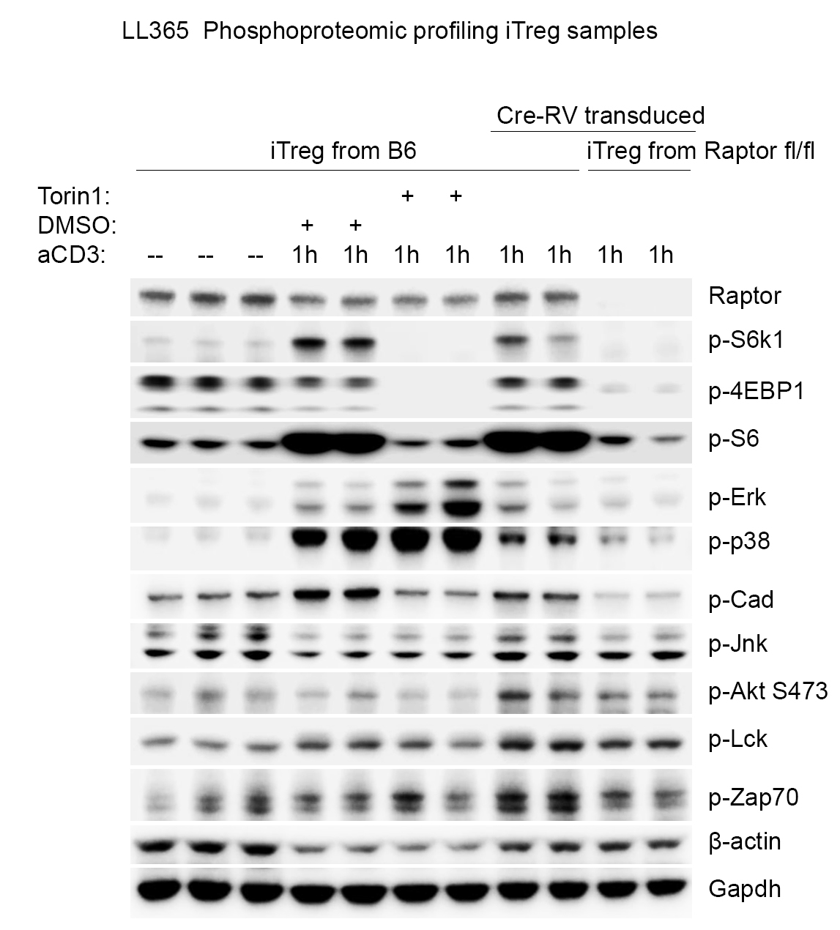
Sample Quality Control by Users (WB)
Sample #: 1 2 3 4 5 6 7 8 9 10 11

Slide 6
Sample Quality Control by Users (WB)
P-4EBP1
0h
0h
0h
1h
1h
1h
1h
1h
1h
1h
1h
WT
WT
WT
WT
WT
Torin
Torin
Cre
Cre
Raptor
Raptor

Slide 7
Sample Quality Control by Users (WB)
P-S6
0h
0h
0h
1h
1h
1h
1h
1h
1h
1h
1h
WT
WT
WT
WT
WT
Torin
Torin
Cre
Cre
Raptor
Raptor

Slide 8
Sample Quality Control by Users (WB)
P-CAD
0h
0h
0h
1h
1h
1h
1h
1h
1h
1h
1h
WT
WT
WT
WT
WT
Torin
Torin
Cre
Cre
Raptor
Raptor

Slide 9
Sample Quality Control by Users (WB)
P-Erk
0h
0h
0h
1h
1h
1h
1h
1h
1h
1h
1h
WT
WT
WT
WT
WT
Torin
Torin
Cre
Cre
Raptor
Raptor

Slide 10
Sample Quality Control by Users (WB)
P-p38
0h
0h
0h
1h
1h
1h
1h
1h
1h
1h
1h
WT
WT
WT
WT
WT
Torin
Torin
Cre
Cre
Raptor
Raptor

Slide 11
Sample Quality Control by Users (WB)
Western and MS detect two distinct phosphorylation patterns (1: 4EBP1, S6, S6K1, CAD; 2: ERK, p38).
MS did not identify the positive site T389, but we identified other S6K1 functional sites: T444, S447, which present distinct phosphorylation pattern compare to T389, the pattern is similar to ERK and P38, suggesting that these sites are possibly to be downstream of MAPK kinase pathway.
P-S6K1 (T444, S447)
0h
0h
0h
1h
1h
1h
1h
1h
1h
1h
1h
WT
WT
WT
WT
WT
Torin
Torin
Cre
Cre
Raptor
Raptor

Slide 12
Sample Quality Control by Users (WB)
P-JNK
0h
0h
0h
1h
1h
1h
1h
1h
1h
1h
1h
WT
WT
WT
WT
WT
Torin
Torin
Cre
Cre
Raptor
Raptor

Slide 13
Sample Quality Control by Users (WB)
P-LCK
0h
0h
0h
1h
1h
1h
1h
1h
1h
1h
1h
WT
WT
WT
WT
WT
Torin
Torin
Cre
Cre
Raptor
Raptor

Slide 14
Sample Quality Control by Users (WB)
P-Zap70
0h
0h
0h
1h
1h
1h
1h
1h
1h
1h
1h
WT
WT
WT
WT
WT
Torin
Torin
Cre
Cre
Raptor
Raptor

Slide 15
Sample Quality Control by Users (WB)
AKT p473
0h
0h
0h
1h
1h
1h
1h
1h
1h
1h
1h
WT
WT
WT
WT
WT
Torin
Torin
Cre
Cre
Raptor
Raptor

Slide 16
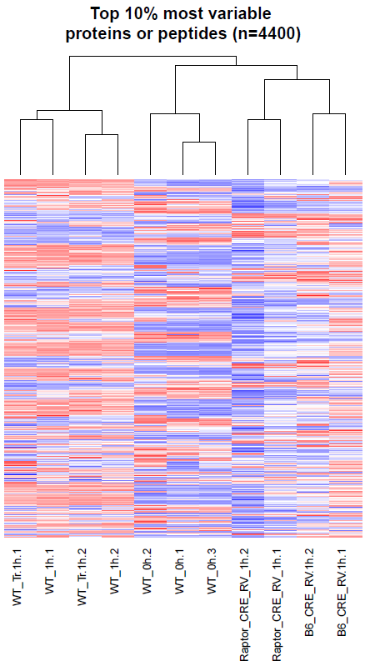
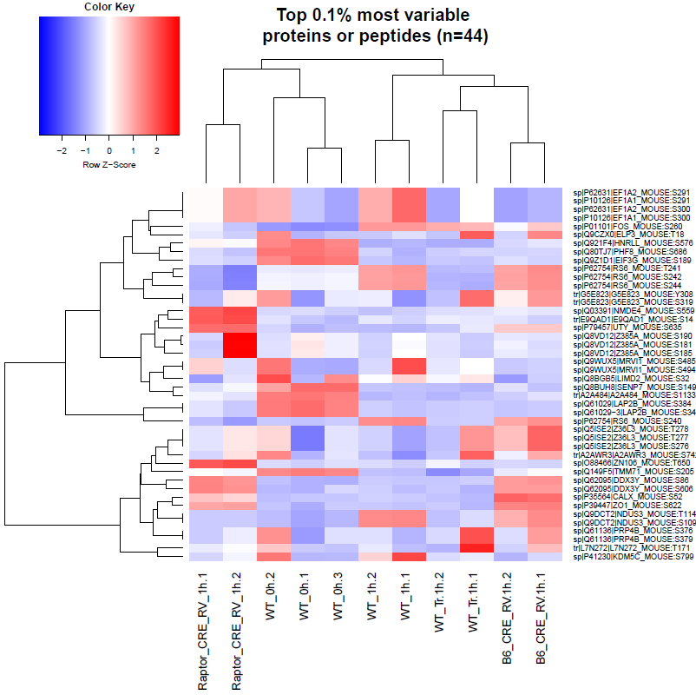
Group clustering looks reasonable
Global phosphoproteome profiles of WT 1h and WT 1h with Torin1 looks similar

Slide 17
Positive control list
Proteomic:
Phosphoproteomic:
Raptor
p-S6 (S235/236)
p-p70 S6k (T389)
p-4E-BP1 (T37/46)
p-Erk1/2 (Thr202/Tyr204)
p-p38 (Thr180/Tyr182)
p-CAD (S1859)
From Lingyun long and Jun Wei

Slide 18
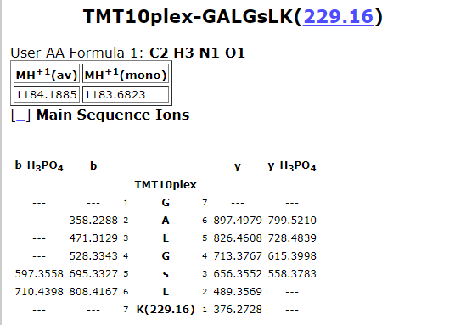
Manual examination on sp|Q9CS74|SGT1_MOUSE (GN: ECD): K.GALGS#LK.S
Theoretical Spetrum:
http://prospector.ucsf.edu/prospector/cgi-bin/mssearch.cgi

Slide 19
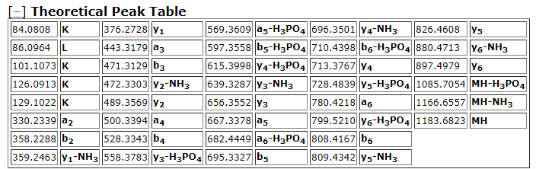
Manual examination on sp|Q9CS74|SGT1_MOUSE (GN: ECD): K.GALGS#LK.S
Theoretical Spetrum:
http://prospector.ucsf.edu/prospector/cgi-bin/mssearch.cgi
K.GALGS#LK.S (p13 #33356, RT: 89.56)
y1
a2
b2
b3
Y4-
H3PO4
y5-
H3PO4
a3
y2
b4
Y3-
H3PO4
a6-
H3PO4
b5-
H3PO4
b6-
H3PO4

